Slide 1
Smart Retail with Ibeacons -27 April 2019
The Game Changers

Slide 2
What are we going to run through next few mins ?
Smart Retail with IBeacons
Smart retail as a term describes how technologies are designed to give the consumer a greater, faster, safer and smarter experience when shopping
Everything around us is becoming increasingly interconnected through technology.
Smart retailing is all about smart devices and smart technology – by connecting smartphone to in-store beacons the whole shopping experience for your customers can suddenly explode into something truly sensational, smart, and very, very cool indeed.
Sensors (such as iBeacons) can be placed onto almost anything, and can connect any number of devices together in some very powerful and innovative ways

Slide 3
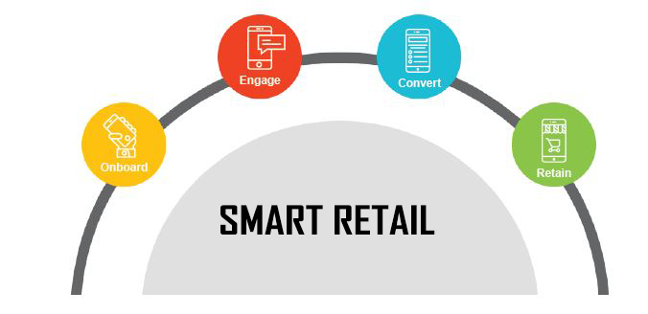
Why Smart Retail ?
To survive and thrive in the e-commerce age, retailers must digitize their bricks-and-mortar stores
Consumers expect smart retailing with a digital shopping experience
The result is greater process efficiency and enhanced customer service
The store of the future: Everything begins with the Customer Journey & Conversions
Customer Engagement, Theft Preventions, In-Store Navigation

Slide 4
What is a Ibeacons ?
iBeacons are Bluetooth low energy (BLE) devices that can be attached to anything, anywhere placed strategically in Retail Stores.
When a customer comes in close proximity to them, they broadcast tiny radio signals, which a user’s smartphone can receive and interpret.
Further, that device sends a unique ID to cloud server
The server checks that ID and responds back, through which communication between signal and smart device is established using a unique ID
E.g., If you were selling digital cameras on one of your shelves, for instance, you could stick an IBeacons underneath, and, when a customer comes nearby, a notification will be automatically sent to that person’s smartphone. If clicked, the user will be directed right to your online store where the product specifications, pictures and pricing can all be displayed.
The great thing about iBeacons is that they create additional value for shoppers while they are in store. And people are already turning to their smartphones to help them with their shopping experiences. A recent survey commissioned by Google found that more than 66% of smartphone users are already using their phones to help them shop and make purchasing decisions when in a physical, bricks and mortar, store.
iBeacons act like digital signs, and the power of these is that they can deliver the right message, at the right time, in the right place, to the right person. They are true innovations to the retail experience, and something that every smart retailer should have in their arsenal.

Slide 5
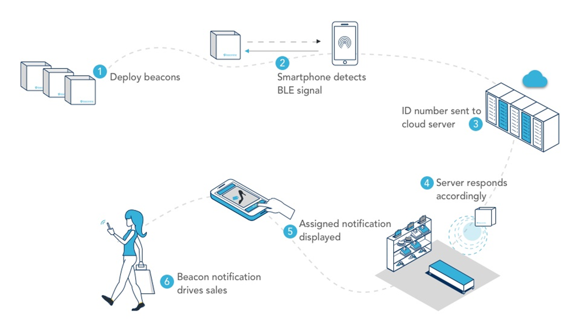
IBeacons Real time Workflow

Slide 6
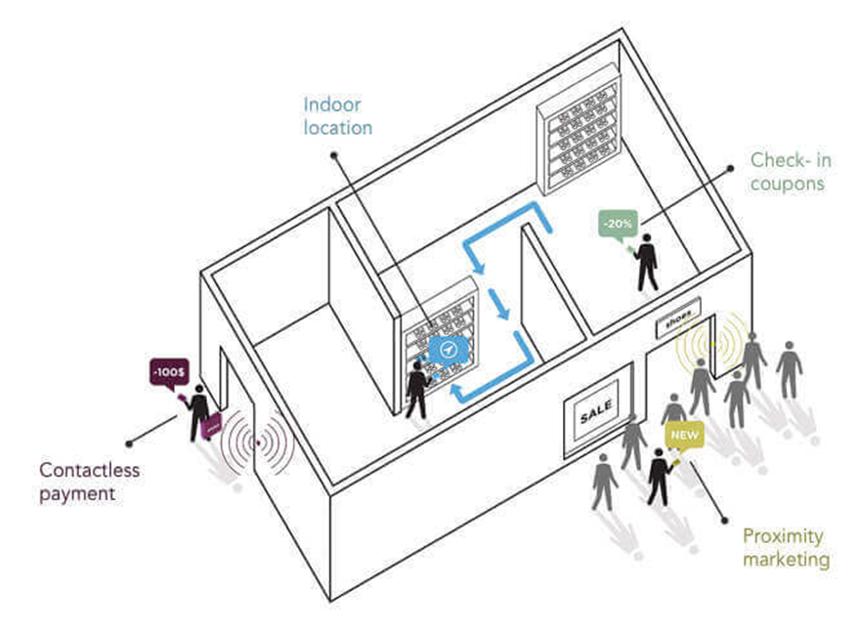
Game Changers use Cases
Push Notification when near Store (Proximity Marketing)
In-Stores Features such as,
Product Group-wise Discounts
Brand Level Discounts
Section Level Discounts
Product Specifications / Information
Branch Wise Offers for a Product searched by customer (based on time spent in a region)
Customer Info – Name/Email/Mobile No keying option if customer wants offer’s Info
Reporting Customer Experience for Retailer enhancement (Using Heat Sensors)
Q-less Payment using various Payment Systems
Option of Installing Stores Application for better shopping experience

Slide 7
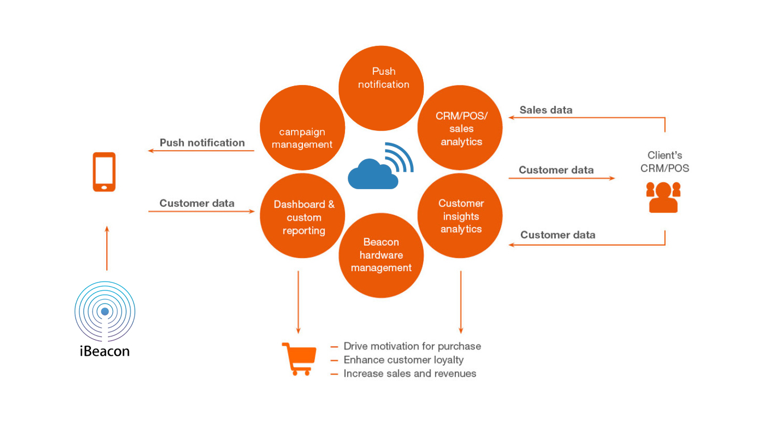
Smart Retailer Benefits

Slide 8
Some Proven Examples of using IBeacons
American Eagle Outfitter:
This leading clothing and accessories retailer has implemented the technology across most their outlets in integration with “Shopkick” application. It will notify customers with current promotions and sale going on at the nearby retailer and other relative actions / notifications
Giant Eagle
The leading supermarket chain with stores in various states of US was an early adapter of this technology. As soon as the device comes within the range, the app will start sending advertisements of brands thus assisting customer in buying relative products.
Universal Music
The American worldwide music corporation has implemented this technology with help of Powa Technologies at their more than 200 locations. It will send current special discounts and offers to customers nearby their stores. Moreover it also identifies customer’s personal preferences and accordingly offer a better purchasing experience
Nice Côte d’Azur Airport
The Côte d’Azur Airport at Nice – Paris, recently launched a beacon-enabled app at the opening of its newly refurbished Terminal 1 retail area to send contextual retail information and promotions to passengers, based on their location in the terminal.
Apple Stores
The founder itself – Apple has deployed this technology across all its stores in US that helps customer in receiving notifications from nearby stores, promotional schemes and loyalty offers. It is also planning to implement the feature of automatically notifying the customer when their device is ready, if the customer had given the device for some service or upgrade

Slide 9
Some Proven Examples of using IBeacons
Macy Stores
Like American Eagle Outfitter, this clothing and accessories retailer has also implemented the technology in integration with “ShopKick”. It helps the customers nearby to store to simply their shopping experience by notifying with products availability, promotions and rewards.
Rubens House Museum
The famous art Museum in Belgium has implemented this technology that helps visitors and customers in locating particular paint or art pieces, notifying and sending them beautiful graphics and images. It also helps them to find the history behind different paintings and art works.
Miami International Airport
The beacon-enabled app at Miami International Airport is helping improve passenger experiences by providing passengers with personalized updates, directions and tips based on their location and needs at the airport and also pulls out the flight schedules of the airport
Exact Editions
The new player in providing magazine application, immediately show the potential of this technology and straight away implemented it, to promote their magazine apps and allowing publishers sell their magazines based on specific locations.
PayPal Hands free in stores
The global and biggest online payment service providing company had started implementing this technology that assists customer with special offers and pay for products and services.
LetsNurture is leading solution provider company in this technology and if you want to promote your business with the help of this technology then we are ready to help you.

